Slide 1
INTRO TO MARIE
DR. ABRAHAM
UTRGV

Slide 2
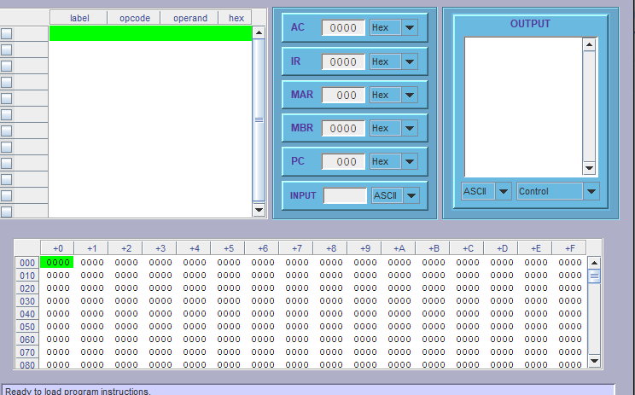
MARIE
Make sure you have installed JAVA SDK, Otherwise will not work
Install MARIE, Go the directory where you installed MARIE and launch MarieSim. It should open like this:

Slide 3
Write your first program
Go to file edit and write your first assembly program. I did this just to show you input and output.
org 100 ;store program starting at Hex 100
Input ;read from keyboard into AC
Output ;output into designated monitor memory
Halt ; stop program
Save the program and compile it
Run the compiled program (.mex) which can be loaded any time.
See next slide. Inspect memoryword100, 101 and 102

Slide 4
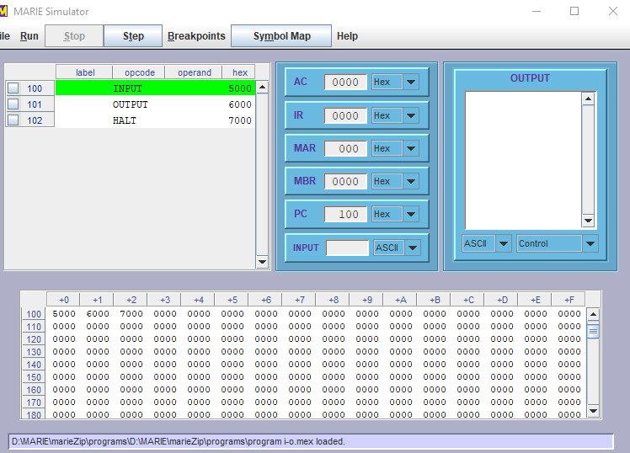
See mem words starting at 100. Check all registers.

Slide 5
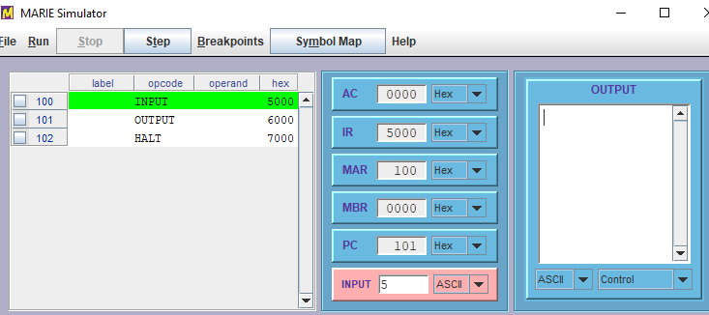
Step through the program inspect registers
After the first instruction is read from mem 100, we see AC has 0 (we have not pressed enter with the input of 5)
IR has 5000 from mem 100
MAR has 100 (that’s from where we read the first instruction)
MBR has nothing as we have not retried any data from mem.
PC of course has the next word address of 101

Slide 6
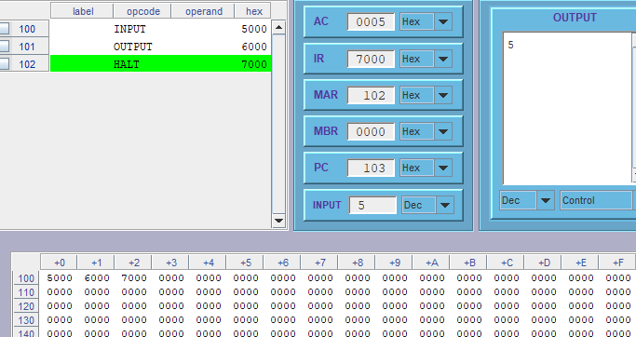
Step through program
Make sure to put input and output to decimal or whatever you choose.
After you press enter for input (with 5 decimal in it), AC gets 5, MAR gets 102 to output, PC has 103 which has nothing in it. You will see 5 in the output screen.

Slide 7
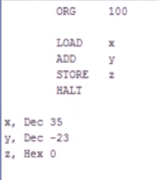
Embedded data
Input and output is a pain, usually it is read as ASCII and has to be converted. Thus in assembly it is a practice to bypass read/write and place the data directly (which as the practice in ForTran as well)

Slide 8
Good source
https://www.youtube.com/watch?v=RvFAIPlfvLc&t=19s

